Slide 1
Toxicity from Textiles
The Textile Industry - serious environmental polluter
Direct skin contact with toxic textiles a growing problem
Toxic chemicals in textiles a major health problem
The majority of the population is unaware of problems
Symptoms are not recognised as related to textile toxins
Downloaded and produced by www.paingenie.com

Slide 2
Some Synthetic Textiles
Polyester fibre is used in all types of clothing, either alone or blended with fibres such as cotton.
Aramid fibre (e.g. Twaron) is used for flame-retardant clothing, cut-protection, and armour.
Acrylic is a fibre used to imitate wools, including cashmere, and is often used in replacement of them.
Nylon is a fibre used to imitate silk; it is used in the production of pantyhose. Thicker nylon fibres are used in rope and outdoor clothing.
Spandex/Elastane (trade name Lycra) is a polyurethane product that can be made tight-fitting without impeding movement. It is used to make activewear, bras, and swimsuits.
Olefin fibre is a fibre used in activewear, linings, and warm clothing. Olefins are hydrophobic, allowing them to dry quickly. A sintered felt of olefin fibres is sold under the trade name Tyvek.

Slide 3
Toxic Chemicals used in Textiles/ Footware
Maneb
Ethylene Diamine
Ethylene Thiourea (Metabolite of Ethylene Diamaine
Nonylphenol Ethoxylate

Slide 4
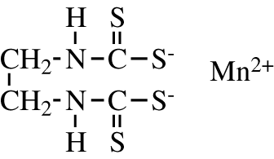
Maneb
Maneb fungicide used for crops and footware
Polymeric complex of manganese with ethylene bis(dithiocarbamate)

Slide 5
Uses of Maneb – EPA 2005
Maneb is used on a wide variety of food/feed crops, including fruit and nut crops, vegetable crops, field and forage crops, grapes, field crop seeds, and others; ornamental plants in nurseries and greenhouses; and sod farms. There are no residential uses, and no agricultural
uses that could result in exposure to Maneb in residential settings.
Approximately 2.5 million pounds of Maneb are used annually, mostly on almonds, lettuce, peppers, and walnuts.
Maneb is not a Restricted Use Pesticide (RUP)
http://www.epa.gov/oppsrrd1/REDs/factsheets/maneb_fact.pdf

Slide 6
Human Health Effects:
Numerous Case reports/studies show a wide range of health effects from minor to serious.¹
Chromosomal aberrations in cultured human lymphocytes treated with maneb (0.5, 15, or 30 ug/mL) was 10-20% greater than in controls.¹
Maneb can be metabolised to Ethylene Thiourea- shown to cause cancer.¹
Chronic exposure to Maneb associated with Parkinsonism, which is likely ascribed to exposure to the manganese moiety.²
http://www.sciencedirect.com/science/article/pii/S0165614709001229
http://toxnet.nlm.nih.gov/cgi-bin/sis/search/a?dbs+hsdb:@term+@DOCNO+4063

Slide 7
Observations on Maneb using EAV
Over years of testing I have observed disturbances with Manganese- usually excess.
This excess was traced to Shoe insoles, some golf club grips and steering wheels.
I suspect the problem arises from the release of the inorganic Manganese from the absorbed compound
It is used as a pesticide and I found it to be present in some Basmati Rice.

Slide 8
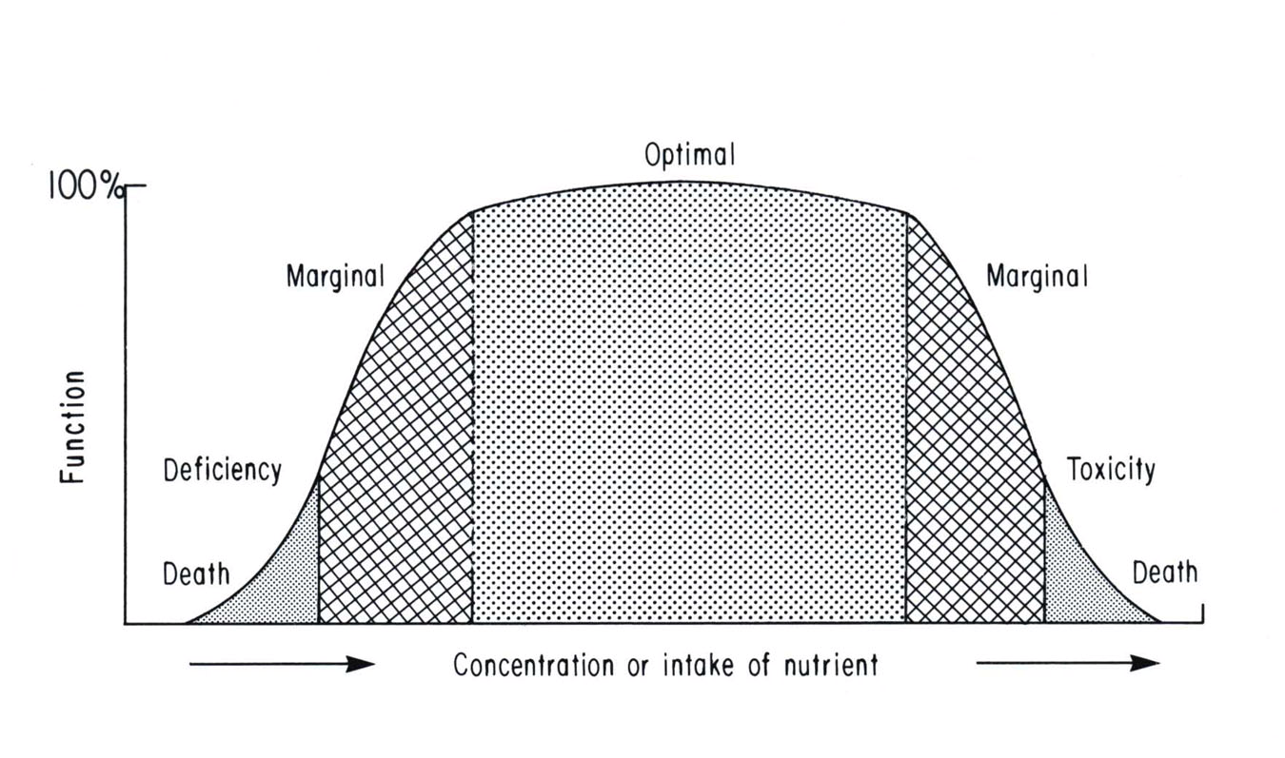
Optimal Concentration of Trace Minerals
The dependence of biologic function on the tissue concentration of an essential trace element (Copper)
This is typical for essential trace elements that also have toxic effects , e.g. Iron, Molybdenum
Reproduced from Meretz, W. The essential trace elements. Science 213:1332 (1981).

Slide 9
Functions of Manganese
ENZYME OR REACTION | NORMAL FUNCTION | DEFICIENCY
Superoxide Dismutase | Free radical detoxification | Free radical damage
Isocitrate Dehydrogenase | Citric Cycle reaction | Block of energy metabolism
Glucokinase | Glycolysis reaction | Block of energy metabolism
Arginase. | Urea formation | Block of Nitrogen Excretion
Production of Mucopolysaccharides | Growth and maintenance of connective tissue, cartilage and bone | Musculo-skeletal disease and weakness.
Osteoblast and Osteoclast activity | Bone mineralisation | Osteoporosis and osteopenia
Melanin Production | Skin pigmentation | ? Vitiligo
Dopamine production | Neurotransmission | Nerve and brain function
Fatty Acid synthesis | Nerve tissue and cell membrane production | Degenerative,allergic diseases
Fatty Acid synthesis | Immune system modulation. | Allergies, autoimmune disease
Fatty Acid synthesis | Cholesterol and steroid hormone synthesis | Endocrine Problems
Thyroxin synthesis | Thyroid gland activity | Hypothyroidism
Milk production | Lactation | Lactation Problems

Slide 10
Ethylene Diamine (EDM)
Used in the following products
Fuel Additives
Bleach Activators
Chelating Agents*
Fungicides
Spandex/Elastane Fibers*
Urethanes

Slide 11
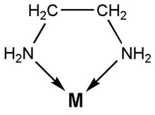
Ethylene Diamine Structure
The two nitrogen atoms provide two free electrons which enable it to bind to metals so it acts as a chelating agent

Slide 12
Observations of Effects of EDM
By testing patients exposed to Elastane I have observed deficiencies of the following-
Zinc
Copper
Manganese
Iron
Chromium
Iodine

Slide 13
Functions of Zinc (selection)
ENZYME OR REACTION | NORMAL FUNCTION | DEFICIENCY
DNA Polymerase | Gene Repair - Healing | Altered genes Defective healing
Alkaline Phosphatase | Phagocytosis | Weakened immunity
Alcohol Dehydrogenase | Phase I detoxification | Accumulation of toxins/Allergies
RNA Polymerase | Synthesis of detoxifying enzymes | Accumulation of toxins
Carbonic Anhydrase | Carbon dioxide transport | Defective respiration Acid/Base Bal.
 | Aldehyde metabolism | Aldehyde adduct reactions
Retinol Binding Protein | Release of Vit.A from Liver | Vitamin A deficiency
Pyridoxine Kinase | Conversion of Vit B6 to active | Block of metabolic pathways
Glutamate dehydrogenase | Glutathione peroxidase synthesis | Blocked detoxification reaction
? Enzyme dysfunction | Skin formation | Eczema, Acne, Psoriasis
? Enzyme dysfunction | Growth Hormone levels | Growth deficiency
? Enzyme dysfunction | ? Hormone deficiencies | Delayed Sexual Maturation
Aromatase | Convert Testosterone to Estrogens | Prostatic Hypertrophy Male dysfunction

Slide 14
Functions of Copper
Cofactor for enzyme Superoxide Dismutase, which converts potentially harmful superoxide anions.
Cofactor for Oxygenases, including Cytochrome Oxidase in the Electron Transport Chain
Cofactor for Lysyl Oxidase for cross-linking of Collagen and Elastin
Chromium
Iron
Iodine

Slide 15
Functions of Iron
Enzyme/Reaction | Normal Function | Deficiency
Ribonucleotide Reductase | DNA synthesis | Various Problems
Myeloperoxidase | Leucocyte Activity | Impaired bacterial immunity
Catalase | Degradation of Peroxide | Tissue/ metabolite damage
Tryptophan Hydroxylase &Tyrosine Hydroxylase | Dopamine and Serotonin formation | Neurological disorders
Tryptophan Oxygenase | Tryptophan Degradation | Perception and Mood Changes ?Schizophrenia
Electron Transport and Oxidative Phosphorylation | Production of ATP and Energy | Impaired Cellular Metabolism
Cytochrome P450 | Detoxification | Damage from Toxins
Hemoglobin Formation | Respiration | Anemia, Lack of energy

Slide 16
Functions of Copper
Enzyme/Reaction | Normal Function | Deficiency
Cytochrome Oxidase | Energy production | Lack of Energy
Superoxide Dismutase | Metab. Free radicals | Toxic damage
Lysyl Oxidase | Crosslinking Collagen and Elastin | Defective connective tissue. Aneurisms
Dopamine beta Hydroxylase | Catecholamine Production | Neurological and adrenergic problems
Amine Oxidases | Inactivation of Histamine, Tyramine etc | Hypersensitivity, Allergy Reactions
Tyroinase Alpha Amidating enzyme Phospholipid Synthesis | Melanin Production Peptide Hormone Production Myelin SheathFormation | ?Vitilig Unknown Neurological Dise

Slide 17
Ethylene Thiourea
Ethylene Thiourea is primarily used as a vulcanising agent for the production of Neoprene and Polyacrylate rubbers.
It is the main in-vivo metabolite of Maneb and many of the toxic effects of Maneb are attributed to Ethylene Thiourea

Slide 18
Ethylene Thiourea - Toxicity
The following effects have been observed
Decreased p450 content and Aniline Hydroxylase activity in rat liver microsomes and the Yeast Saccharomyces Cerivisiae
Liver Toxicity and neoplasm (rat)
Thyroid dysfunction (rat)
Nervous system dysfunction (rat)
Teratogenic effects
Catalase Inhibition
http://resources.metapress.com/pdf-preview.axd?code=x0km1b2ypktndrcw&size=largest

Slide 19
NonylPhenol Ethoxylate
Greenpeace has published research that shows the harsh reality of clothing industries using dangerous chemicals in their clothes. The tests showed that many producers use dangerous amounts of chemicals in their clothes suspected of causing cancer hormonal imbalance and fetal damage. (Article from Finnish newspaper Taloussanomat: 23.8.2011)
Greenpeace's second "Dirty Laundry" research tested 78 products from which 52 contained Nonylphenol ethyxolate.
Manufacturers which clothing contained the poison were for example Nike, Adidas, H&M, Calvin Klein, Converse, Puma and Ralph Lauren,
The test revealed only one pure manufacturer which clothes were free of the chemical, The american Gap.

Slide 20
H&M abandons the poison that causes fetal damage
Finnish blog called Uusi Musta, article 22.9.2011, Terhi reported the news
Greenpeace personnel were surprised by the swift response from H& M

Slide 21
Comments on the Textiles Problem
The careless cavalier attitude of manufacturers is mirrored by the lax behaviour of regulatory authorities
Many people suffer from these poisons without a notion of the cause.
This situation is ideal for the Industrial Pharmaceutical complex and is another example of the broken society wherein the elite profit from the suffering, labour and commerce of the unsuspecting majority.
I am in the process of preparing a report on this topic which I will send to every address that I know. Please give me your email for inclusion.

Slide 22
Contact Details
Anthony Hughes
Natural Medicine Clinic
1 Leopardstown Drive
Blackrock, County Dublin
+353-1-2880352
natmed2@gmail.com
Downloaded and produced by http://www.paingenie.com

